Slide 1

Preprocessing
Center for Health Data Science

Slide 2
Overview
File formats
Trimming and filtering
Read alignment
Quality control
Read count tables

Slide 3
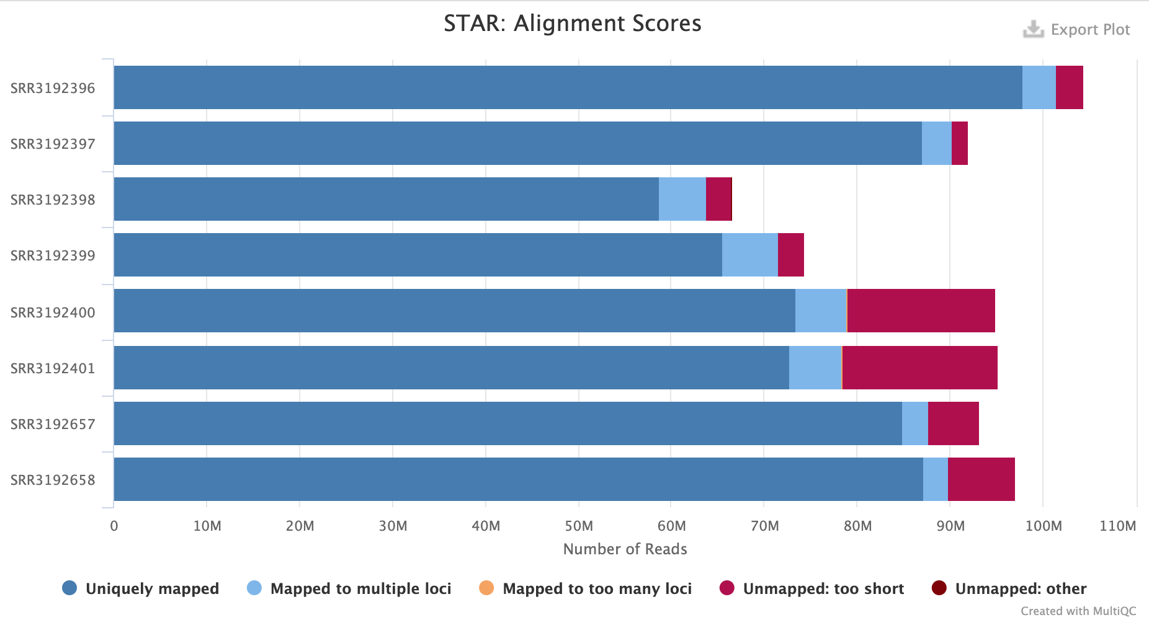
Workflow
Reference genome
fasta file
Genome browser visualization
Sequencer
“raw” reads
Cleaned and trimmed reads
Aligned reads
BigWig file
fastq file
fastq file
SAM file
Remove duplicated reads
Read count table
Quality control check
Gene/Region | Counts
A | 5
B | 3
C | 9
SAM file
MultiQC report

Slide 4
File formats
In bioinformatics we use a plethora of different file formats for different tools and analysis
UCSC Genome Browser provides a detailed description of main file formats and what they should contain
http://genome.ucsc.edu/FAQ/FAQformat
Notes:
UCSC: http://genome.ucsc.edu/FAQ/FAQformat

Slide 5
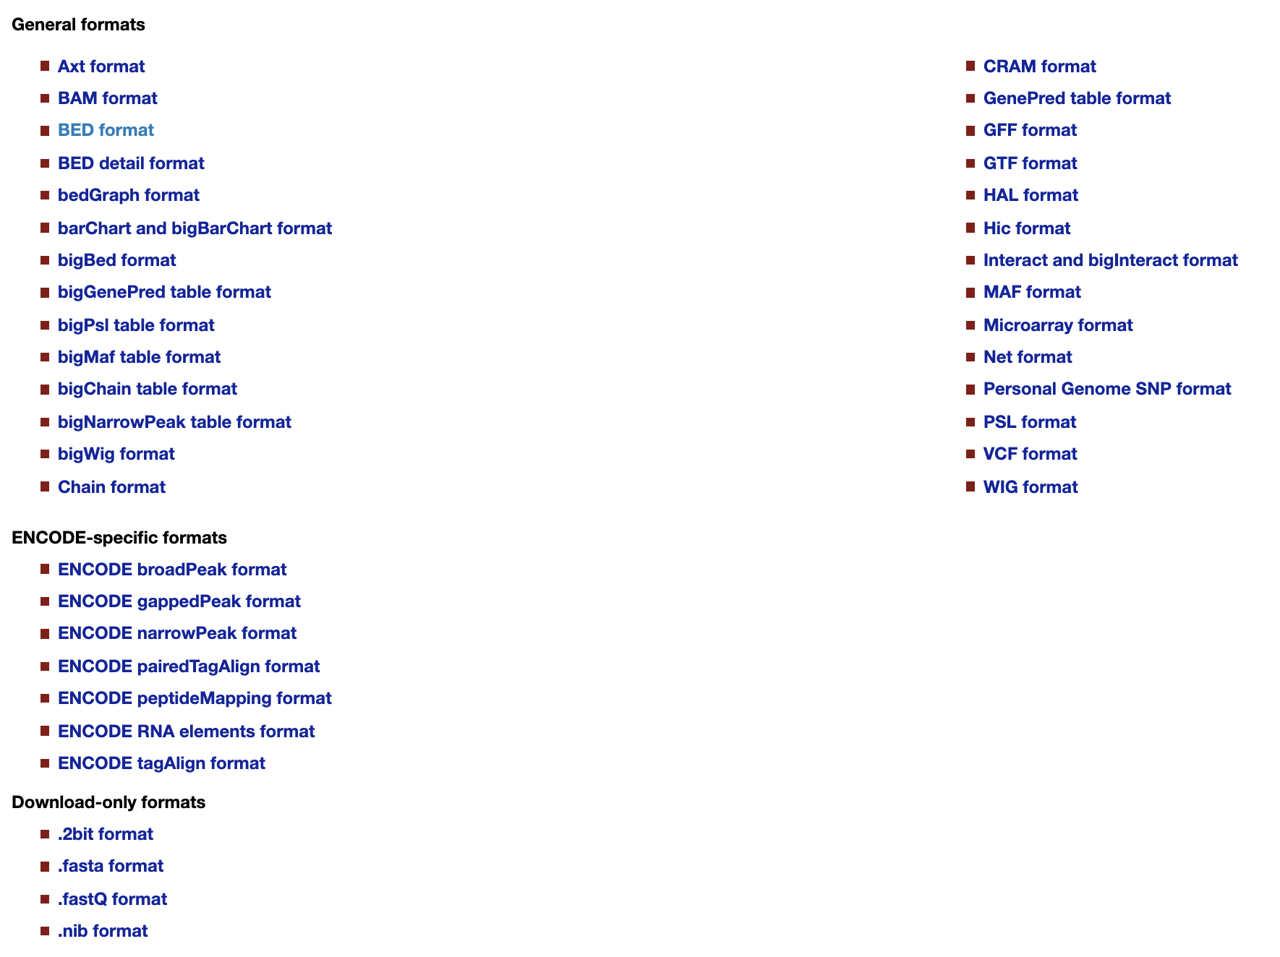
File formats
Notes:
UCSC: http://genome.ucsc.edu/FAQ/FAQformat

Slide 6
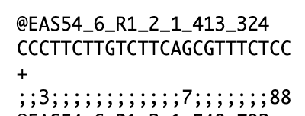
Fastq. Raw read file format
Read information out of the sequencer
Contains
ID of the read. ID and description depends on technology
Sequence
Quality of each nucleotide (Phred score/quality)
We can use Phred score to filter low quality reads
Notes:
Phred Score: http://maq.sourceforge.net/qual.shtml
TrimGalore: https://www.bioinformatics.babraham.ac.uk/projects/trim_galore/

Slide 7
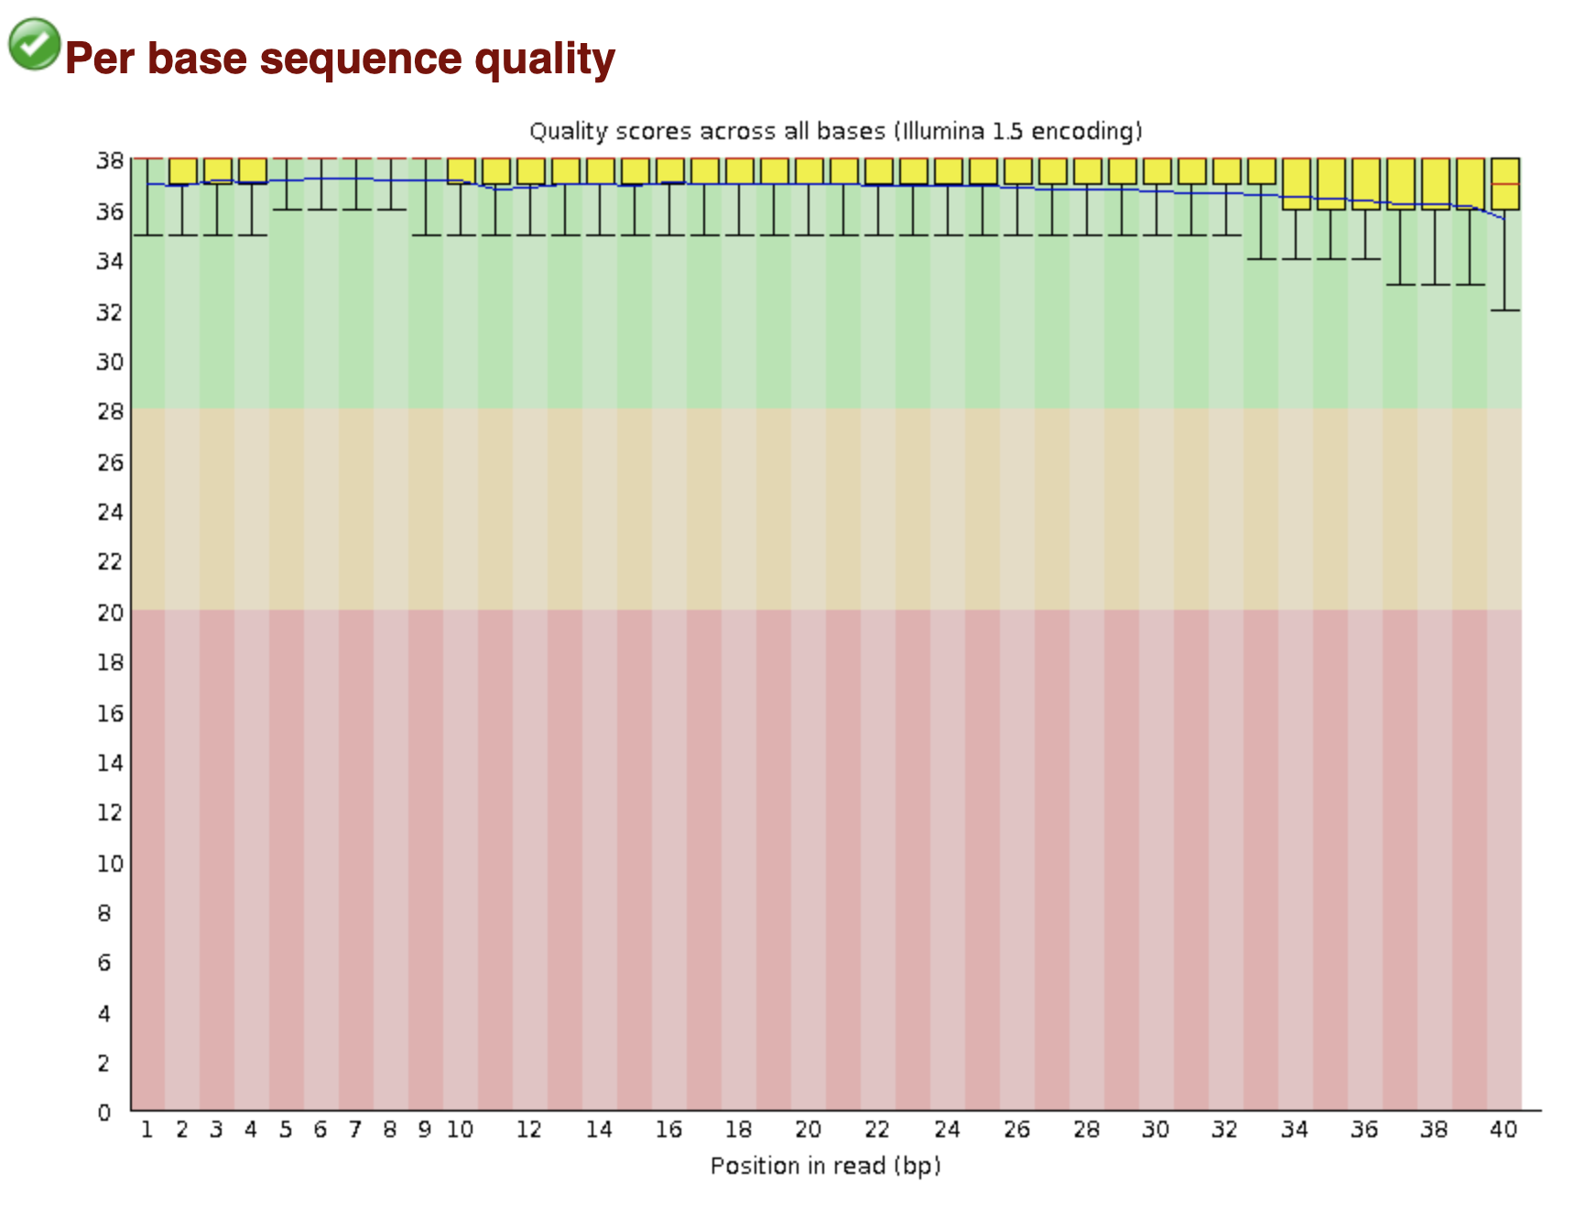
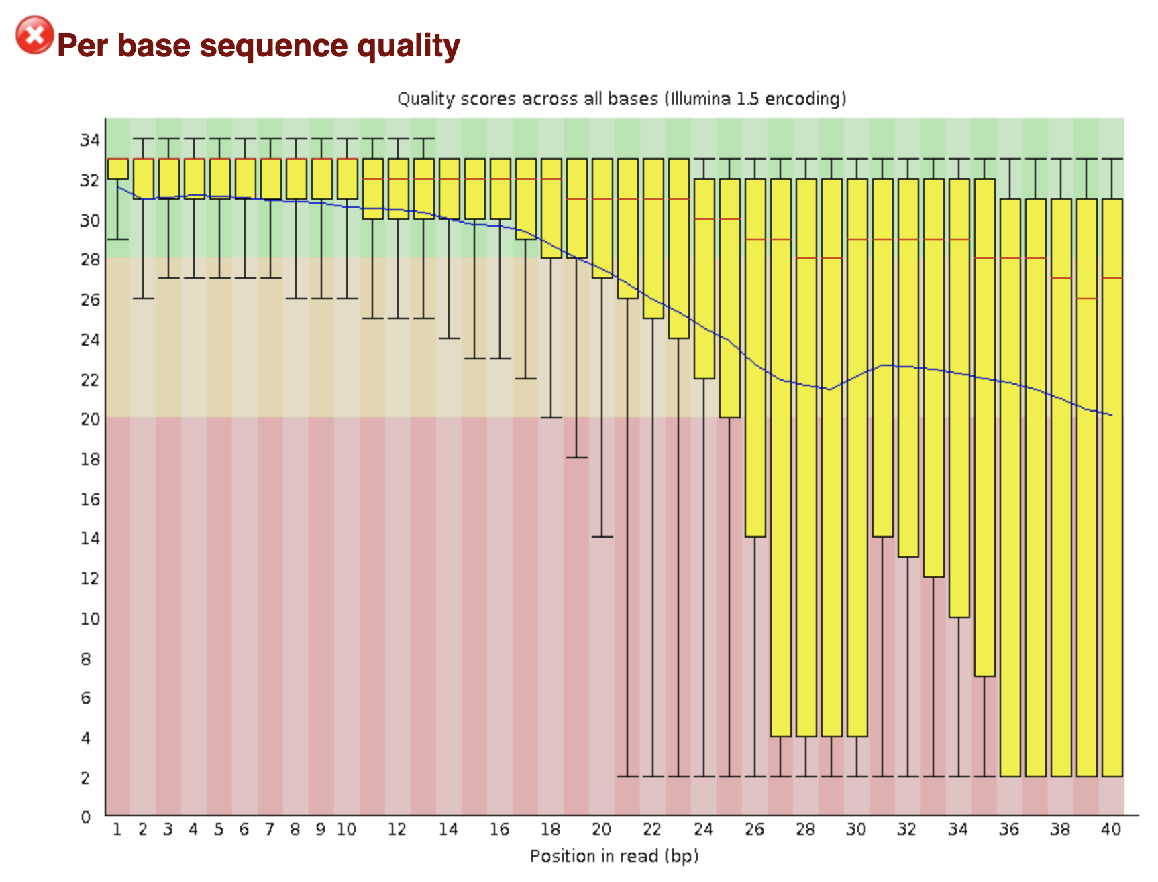
Quality Control. FastQC
Simple way to do some QC checks on raw sequence data
Basic statistics, sequence quality and GC content, duplications, etc
Notes:
fastQC: https://www.bioinformatics.babraham.ac.uk/projects/fastqc/
FastQC checks:
Basic Statistics
Per base sequence quality
Per tile sequence quality
Per sequence quality scores
Per base sequence content
Per sequence GC content
Per base N content
Sequence Length Distribution
Sequence Duplication Levels
Overrepresented sequences
Adapter Content

Slide 8
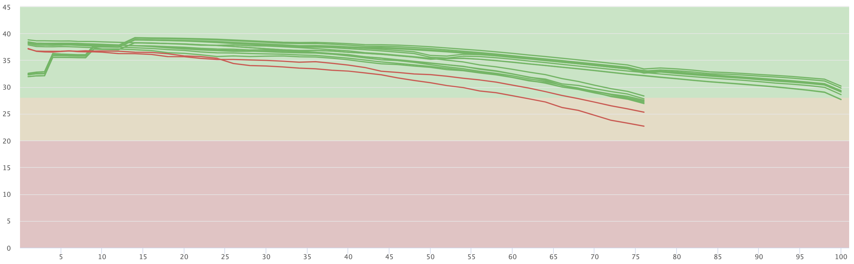
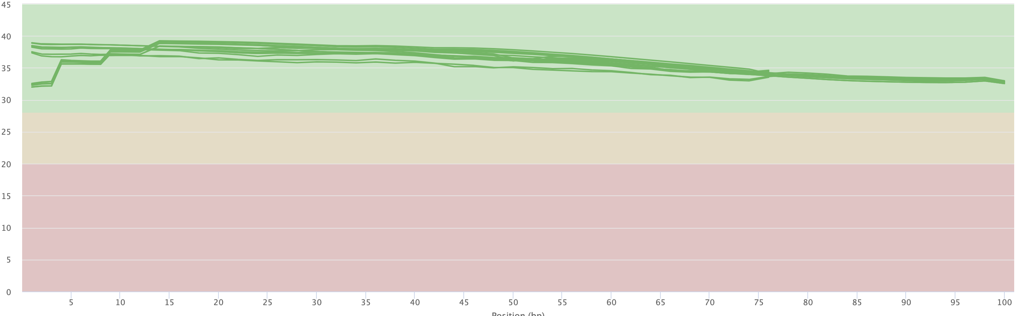
Trimming and filtering
Tools
CutAdapt
TrimGalore
Trimmomatic
Can help to clean your raw sequencing data
Remove adapters, poor reads and poly-A tails, trim poor bases
We do not need to worry about duplicates, unless it is really excessive
Mean Quality scores (raw)
Mean Quality scores (trimmed and cleaned)
Phred score

Slide 9
Read Alignment - Traditional mapping
Tools:
STAR
Bowtie
BWA
HISAT2
Align to reference genome – RNAseq
Before it was normal to map to the exome
We are interested in genes or annotated regions → GTF/GFF3
Always try to align to the newest version of your reference!
Reference
genome
ATAC/ChIP-seq
reads
250 bp
300 bp
350 bp
400 bp
RNAseq
reads
Enhancer?
Genes
A
B
Notes:
STAR: https://hbctraining.github.io/Intro-to-rnaseq-hpc-O2/lessons/03_alignment.html
Bowtie: http://bowtie-bio.sourceforge.net/index.shtml
BWA: http://bio-bwa.sourceforge.net/

Slide 10
Fasta format
>mm10_chr1| Chromosome 1 of Mouse genome version 10
CACACACTTTTCTCACACTATTAGGTAACCCTCTGCCTTATTCCACACTTCCTCCATGAT
GTGCTCCCCGTAGTCACAAAGCCAGCTGGAGACAGACTAGAGCAATGAGCCAAAAGTAGA
CCTTTCCTCCTTTTAACTTGACTGTCTTGAATATTCTGGTACAGTAACAGAAATCTGACT
AGCAGGTCCTTGAGTGAATTCCACCTACATGTGGATATGTGTGAGGATAGAGACCTGTTC
Amino acid or nucleotide sequence
Starts with a single line description ”>”,
Reference IDs or descriptions of the sequence, separated by “|”
Usually used for reference genomes or exomes
Notes:
Human or mouse https://www.gencodegenes.org/

Slide 11
Sequence Alignment Map - SAM/BAM file
SAM format is a generic format for storing large nucleotide sequence alignments
BAM file is the compressed version → Otherwise the files can be huge!
Tools: samtools
A SAM file looks like this…
Notes:
Sam file descriptions:
http://samtools.sourceforge.net/
https://samtools.github.io/hts-specs/SAMv1.pdf

Slide 12
SAM format
You can use samtools to interact with alignment data
Header
Reference name of
the mate/next read
Sequence
segment
@HD VN:1.6 SO:coordinate
@SQ SN:ref LN:45
r001 99 mm10_chr1 7 30 8M2I4M1D3M = 37 39 TTAGATAAAGGATACTG *
r002 0 mm10_chr1 9 30 3S6M1P1I4M * 0 0 AAAAGATAAGGATA *
r003 0 mm10_chr2 9 30 5S6M * 0 0 GCCTAAGCTAA * SA,29,-,6H5M,17,0;
r004 0 mm10_chr5 16 30 6M14N5M * 0 0 ATAGCTTCAGC *
r003 2064 mm10_chr2 29 17 6H5M * 0 0 TAGGC * SA:Z,9,+,5S6M,30,1;
r001 147 mm10_chr1 37 30 9M = 7 -39 CAGCGGCAT * NM:i:1
Reference
name
CIGAR string
Read id
Alignment
description
Read
position
FLAG
Template length
Read
quality
Mapping
quality
Position of the
mate/next read
Notes:
1. QNAME: Query template NAME. Reads/segments having identical QNAME are regarded to come from the same template. A QNAME ‘*’ indicates the information is unavailable. In a SAM file, a read may occupy multiple alignment lines, when its alignment is chimeric or when multiple mappings are given.
2. FLAG: Combination of bitwise FLAGs.
3. RNAME: Reference sequence NAME of the alignment. If @SQ header lines are present, RNAME (if not ‘*’) must be present in one of the SQ-SN tag. An unmapped segment without coordinate has a ‘*’ at this field. However, an unmapped segment may also have an ordinary coordinate such that it can be placed at a desired position after sorting. If RNAME is ‘*’, no assumptions can be made about POS and CIGAR.
4. POS: 1-based leftmost mapping POSition of the first CIGAR operation that “consumes” a reference base (see table below). The first base in a reference sequence has coordinate 1. POS is set as 0 for an unmapped read without coordinate. If POS is 0, no assumptions can be made about RNAME and CIGAR.
5. MAPQ: MAPping Quality. It equals −10 log10 Pr{mapping position is wrong}, rounded to the nearest integer. A value 255 indicates that the mapping quality is not available.
6. CIGAR: CIGAR string. The CIGAR operations are given in the following table (set ‘*’ if unavailable)
7. RNEXT: Reference sequence name of the primary alignment of the NEXT read in the template. For the last read, the next read is the first read in the template. If @SQ header lines are present, RNEXT (if not ‘*’ or ‘=’) must be present in one of the SQ-SN tag. This field is set as ‘*’ when the information is unavailable, and set as ‘=’ if RNEXT is identical RNAME. If not ‘=’ and the next read in the template has one primary mapping (see also bit 0x100 in FLAG), this field is identical to RNAME at the primary line of the next read. If RNEXT is ‘*’, no assumptions can be made on PNEXT and bit 0x20.
8. PNEXT: 1-based Position of the primary alignment of the NEXT read in the template. Set as 0 when the information is unavailable. This field equals POS at the primary line of the next read. If PNEXT is 0, no assumptions can be made on RNEXT and bit 0x20.
9. TLEN: signed observed Template LENgth. If all segments are mapped to the same reference sequence, the absolute value of TLEN equals the distance between the mapped end of the template and the mapped start of the template, inclusively (i.e., end − start + 1). Note that mapped base is defined to be one that aligns to the reference as described by CIGAR, hence excludes soft-clipped bases. The TLEN field is positive for the leftmost segment of the template, negative for the rightmost, and the sign for any middle segment is undefined. If segments cover the same coordinates then the choice of which is leftmost and rightmost is arbitrary, but the two ends must still have differing signs. It is set as 0 for a single-segment template or when the information is unavailable (e.g., when the first or last segment of a multi-segment template is unmapped or when the two are mapped to different reference sequences). The intention of this field is to indicate where the other end of the template has been aligned without needing to read the remainder of the SAM file. Unfortunately there has been no clear consensus on the definitions of the template mapped start and end. Thus the exact definitions are implementation defined.
10. SEQ: segment SEQuence. This field can be a ‘*’ when the sequence is not stored. If not a ‘*’, the length of the sequence must equal the sum of lengths of M/I/S/=/X operations in CIGAR. An ‘=’ denotes the base is identical to the reference base. No assumptions can be made on the letter cases.
11. QUAL: ASCII of base QUALity plus 33 (same as the quality string in the Sanger FASTQ format). A base quality is the phred-scaled base error probability which equals −10 log10 Pr{base is wrong}. This field can be a ‘*’ when quality is not stored. If not a ‘*’, SEQ must not be a ‘*’ and the length of the quality string ought to equal the length of SEQ.

Slide 13
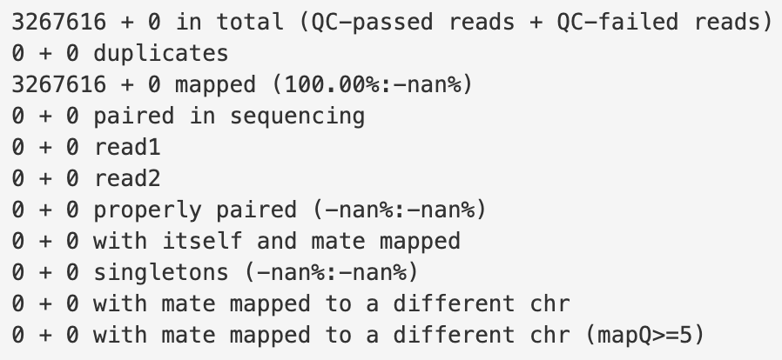
Samtools flagstat
Samtools flagstat will check your sam/bam files and give you general information about the aligned reads.
Notes:
Samtools flagstat: http://www.htslib.org/doc/samtools-flagstat.html

Slide 14
Read count tables
Tools:
STAR
HISAT2
bedtools
Rsubread
Most of times is this the end goal!
Matrix of read counts per gene or per genomic region
bam file reads
Reference
sequence
100 bp
150 bp
200 bp
250 bp
300 bp
350 bp
400 bp
Gene/Transcript | Counts
A | 5
B | 3
C | 9
A
B
C
Genes/Transcripts (GTF/GFF)
Notes:
Bedtools: https://bedtools.readthedocs.io/en/latest/
STAR aligner: https://hbctraining.github.io/Intro-to-rnaseq-hpc-O2/lessons/03_alignment.html
Star aligner can do read count tables with the “--quantMode GeneCounts” option
Rsubread: https://bioconductor.org/packages/release/bioc/html/Rsubread.html

Slide 15
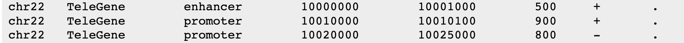
GFF/GTF formats
General Feature Format (GFF3). Tab separated file
Contains genomic features: promoter, enhancer, exon, gene, etc.
Column 9 contains attributes: gene id, gene name, transcript id, etc.
Gene Transfer Format (GTF). Pretty much the same
seqid
feature
end
strand
source
start
score
frame
ID=ENSMUSG00000102693.2;gene_id=ENSMUSG00000102693.2;gene_type=TEC;gene_name=4933401J01Rik;
level=2;mgi_id=MGI:1918292;havana_gene=OTTMUSG00000049935.1
gene_id "ENSMUSG00000102693.2"; gene_type "TEC"; gene_name "4933401J01Rik";
level 2; mgi_id "MGI:1918292"; havana_gene "OTTMUSG00000049935.1"
Notes:
GFF3: https://www.ncbi.nlm.nih.gov/datasets/docs/v1/reference-docs/file-formats/about-ncbi-gff3/
seqname - The name of the sequence. Must be a chromosome or scaffold.
source - The program that generated this feature.
feature - The name of this type of feature. Some examples of standard feature types are "CDS" "start_codon" "stop_codon" and "exon"li>
start - The starting position of the feature in the sequence. The first base is numbered 1.
end - The ending position of the feature (inclusive).
score - Currently only provided for alignments, if they contain a score named “score”. The definition of this score may vary depending on the type of alignment.
strand - Valid entries include "+", "-", or "." (for don't know/don't care).
phase - If the feature is a coding exon, frame should be a number between 0-2 that represents the reading frame of the first base. If the feature is not a coding exon, the value should be ".".
attributes - All lines with the same group are linked together into a single item.

Slide 16
Pseudomapping & Quantification
Alignment and quantification in one step
4 times faster than the fastest regular alignment tools.
Memory usage is often 10 fold lower
Easy to use! Download their data and calculate your count matrices
Precomputed indexes for several species:
Human
Mouse
Tools:
Salmon
Kallisto
Bray, Nicolas L., et al. "Near-optimal probabilistic RNA-seq quantification." Nature biotechnology 34.5 (2016): 525-527.
Notes:
The input consists of a reference transcriptome and reads from an RNA-seq experiment.
An example of a read (in black) and three overlapping transcripts with exonic regions as shown.
An index is constructed by creating the transcriptome de Bruijn Graph (T-DBG) where nodes (v₁, v₂, v₃, ... ) are k-mers, each transcript corresponds to a colored path as shown and the path cover of the transcriptome induces a k-compatibility class for each k-mer.
Conceptually, the k-mers of a read are hashed (black nodes) to find the k-compatibility class of a read.
Skipping (black dashed lines) uses the information stored in the T-DBG to skip k-mers that are redundant because they have the same k-compatibility class. (e) The k-compatibility class of the read is determined by taking the intersection of the k-compatibility classes of its constituent k-mers.

Slide 17
Workflow
Reference genome
fasta file
Genome browser visualization
Sequencer
“raw” reads
Cleaned and trimmed reads
Aligned reads
BigWig file
fastq file
fastq file
SAM file
Remove duplicated reads
Read count table
Quality control check
Gene/Region | Counts
A | 5
B | 3
C | 9
SAM file
MultiQC report

Slide 18
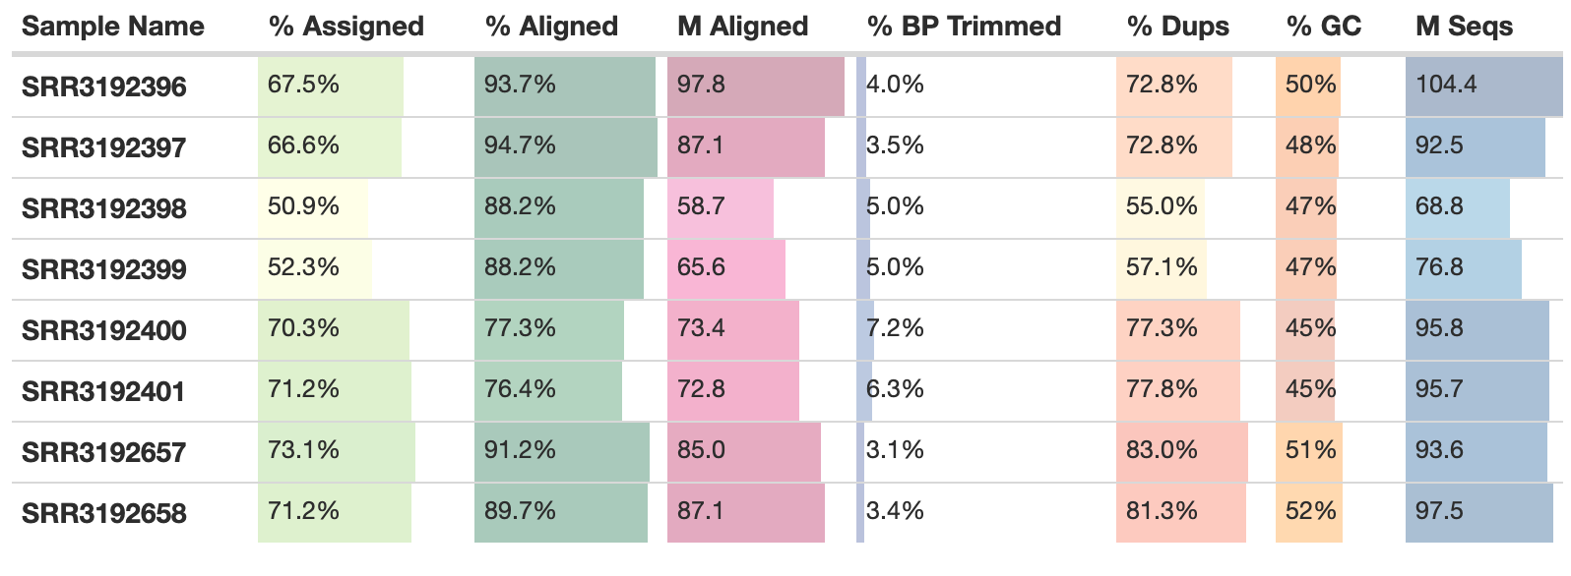
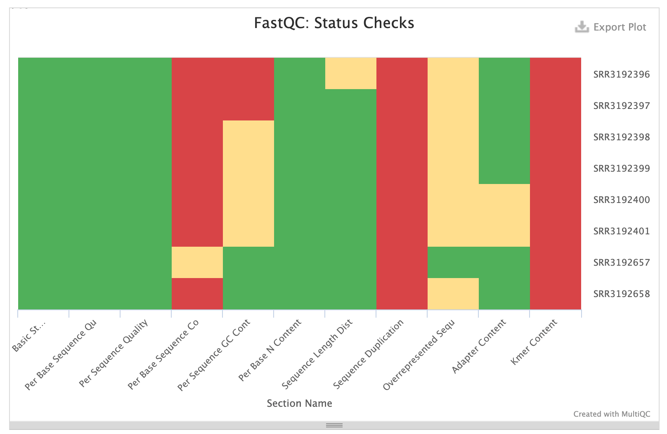
MultiQC reports
Summarises all kinds of reports:
FastQC
Trimming
Alignment
Feature counts
Differential Expression
Notes:
MultiQC: https://multiqc.info/

Slide 19
pipelines
Summarised Workflow
Bioinformatics community for curated pipelines
Completely reproducible, following gold standards and easy to implement
More and more pipelines are being introduced and updated
Bulk RNAseq
Single Cell RNAseq
ATACseq
ChIPseq
HICseq
https://nf-co.re/pipelines
Notes:
https://nf-co.re/pipelines

